Slide 1
Programming Fundamentals
By
Shazmeen Batool

Slide 2
Lab Task 1
Write a C++ program to simulate flipping a coin event using rand().

Slide 3
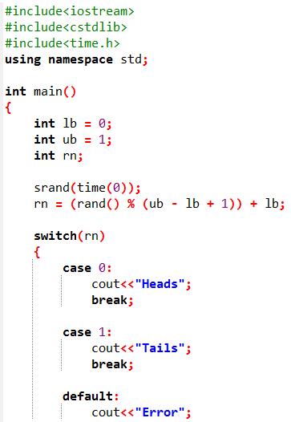


Slide 4
Lab Task 2
Write a C++ program to simulate rolling a six-sided dice event using rand().

Slide 5
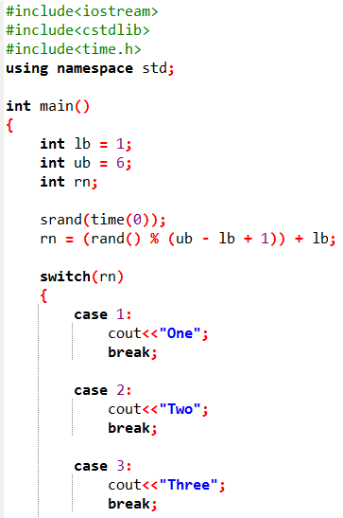
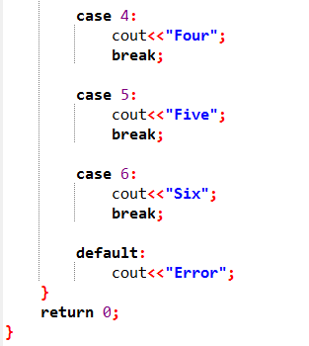

Slide 6
Lab Task 3
Write a C++ program to input an upper bound by user and print all numbers up to that limit?

Slide 7
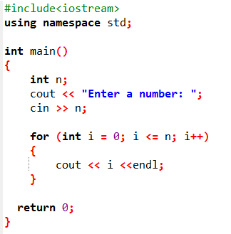
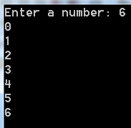
Also practice this code using while loop.
Output

Slide 8
Lab Task 4
Write a C++ program to input an upper bound and separate even & odd from that limit?

Slide 9
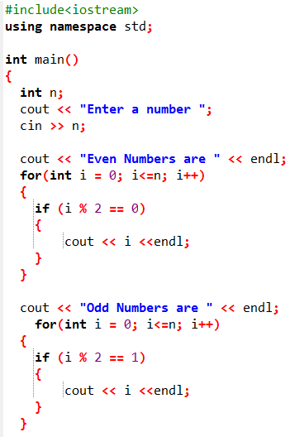
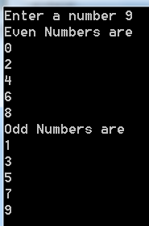

Also practice this code using while loop.
Output

Slide 10
Lab Task 5
Write a C++ program that prints complete alphabets using for loop? (a-z)

Slide 11
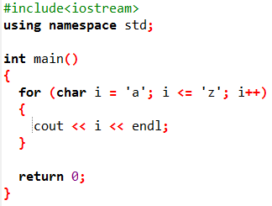
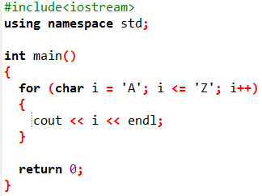
Also practice this code using while loop.
Uppercase (A – Z)

Slide 12
Lab Task 6
Write a C++ program that ask the user a number and prints the table of that number up to 10?

Slide 13
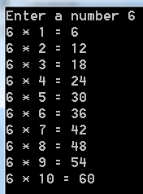
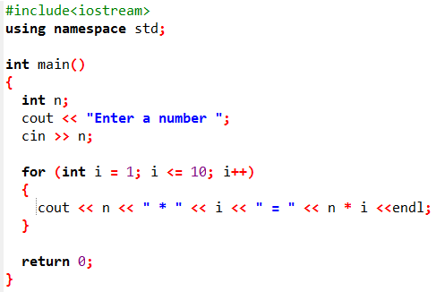

Slide 14
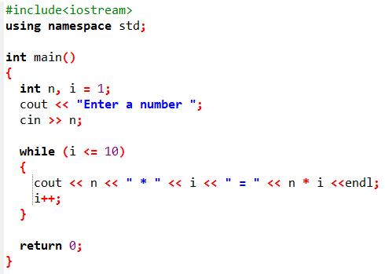
Using while loop.
Also practice this code using do while loop.

Slide 15
Lab Task 7
Write a C++ program that displays the product of all odd numbers from 1 to 10 using for loop?

Slide 16
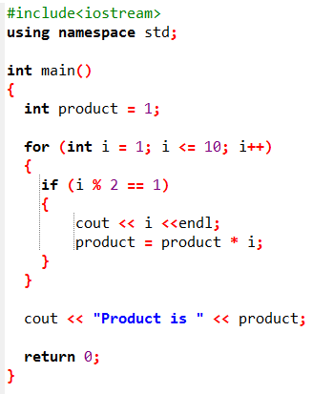
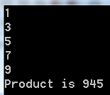
Output

Slide 17
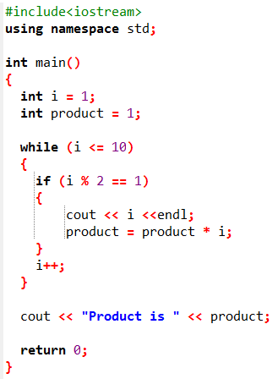
Also practice this code using do while loop.
Using while loop.
Output

Slide 18
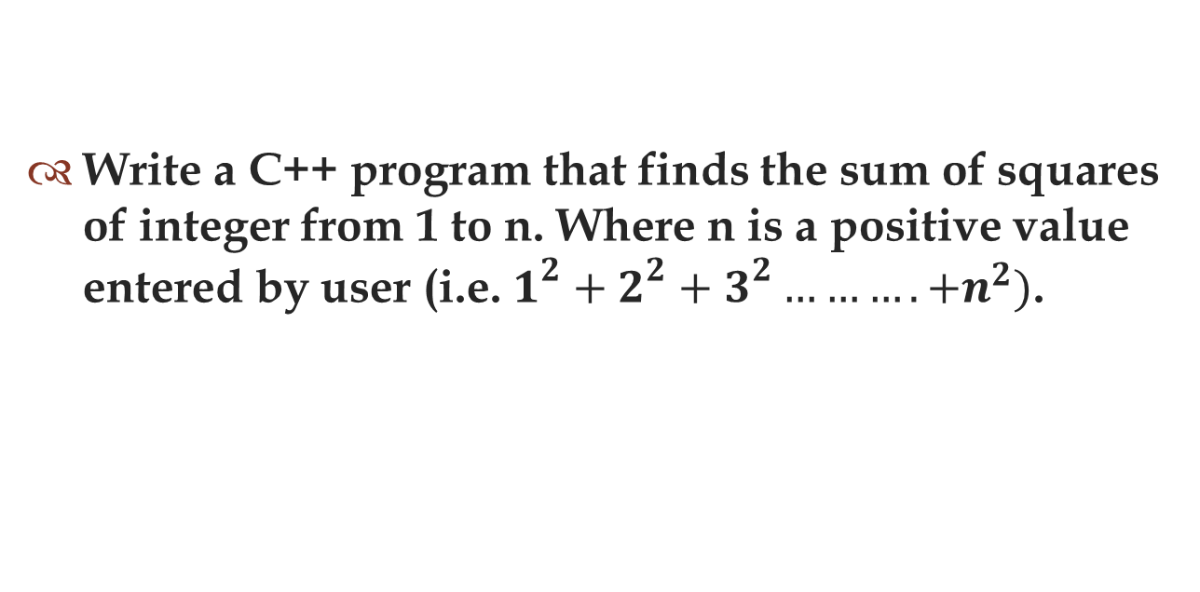
Lab Task 8
Write a C++ program that finds the sum of squares of integer from 1 to n. Where n is a positive value entered by user (i.e. $1^{2}+2^{2}+3^{2}……….+n^{2})$.

Slide 19
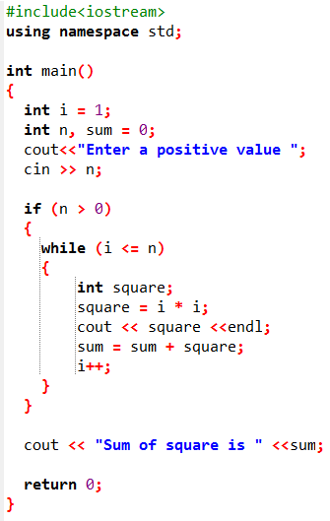
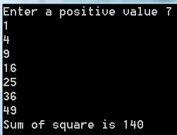
Also practice this code using for loop.
Output

